Slide 1

Lessons Learned Presentation
Aaron Stewart
ECE 4971 – F24, Team 1
Micah Rentschler

Slide 2
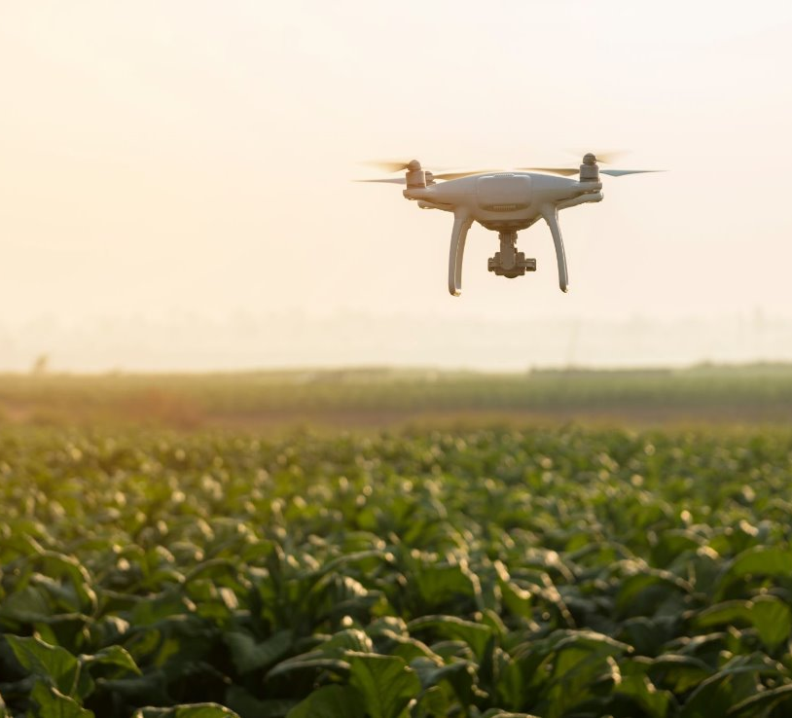
Outline
Project Overview
What Went Well
What Didn’t Go Well
Lessons Learned
Best Practices and Improvements
Skills Learned

Slide 3
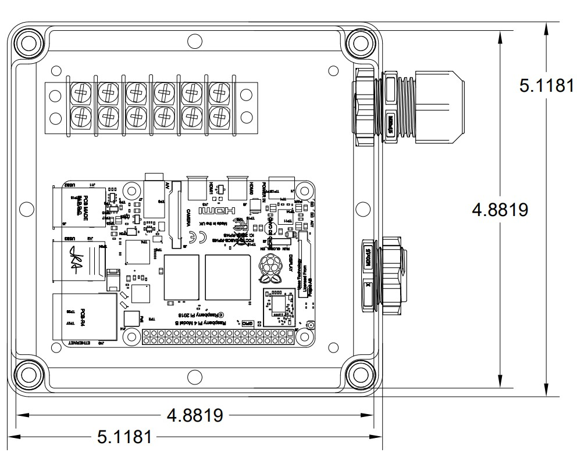
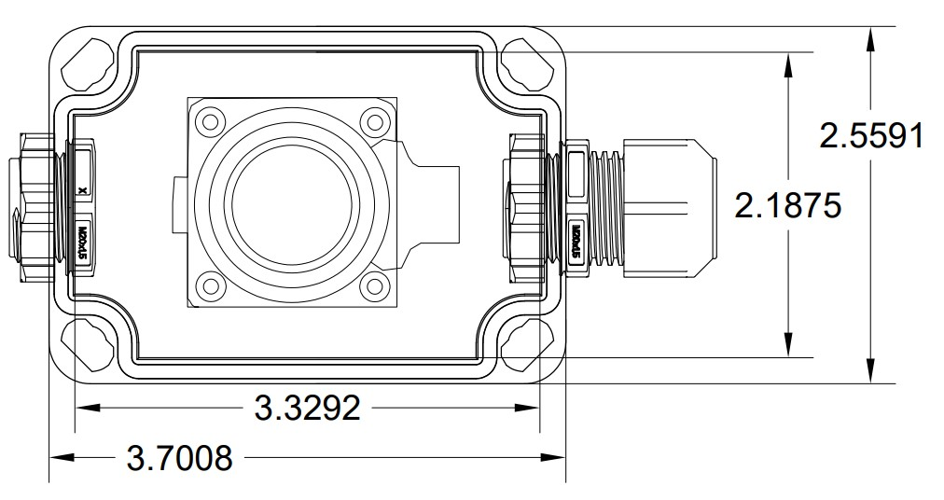
Project Overview
Drone Tracking
Receiver, Website, Database, Power, Camera (Soft/Hard)ware
Remote ID signal for tracking
Website and Database stores data
Camera Hardware System
Point and Shoot
Targets Drone or Operator

Slide 4
What Went Well
Defining project requirements early
Being proactive with deadlines
Constant contact with team and advisor
System design and testing

Slide 5
What Didn’t Go Well
Signoffs and Detail Design
System implementation
"Moving goalposts" for requirements
Not buying enclosures for design

Slide 6
Lessons Learned
Start Designs as soon as possible
Give some breathing room with constraints
Be cautious with where you make component purchases
Don't rely on components being present in the lab

Slide 7
Best Practices
ASK QUESTIONS/FOR HELP
Don’t be afraid of making a mistake
Start early, finish strong
Plan for things to go wrong, act accordingly

Slide 8

Skills Learned
Camera Specs (ISO, Focal Length) and Usage
Ground-Up Design (AutoCad)
Raspberry Pi OS

